Slide 1

Haldane Model
Bo Zhao
School of Engineering
September 19, 2024
1

Slide 2
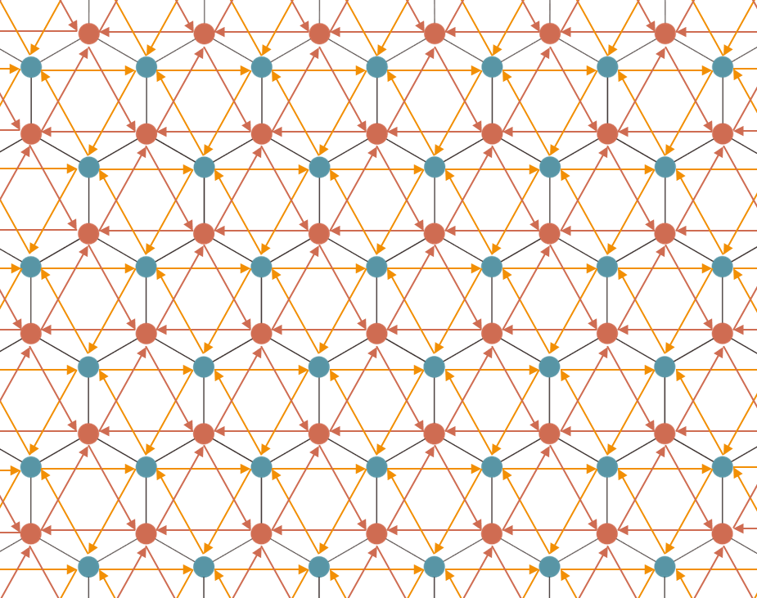
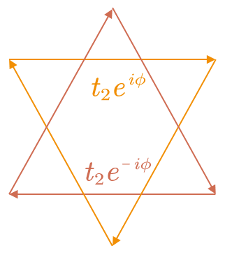
Haldane Model
Introduction
Graphene
Next-neighbor coupling
Haldane Model

Slide 3
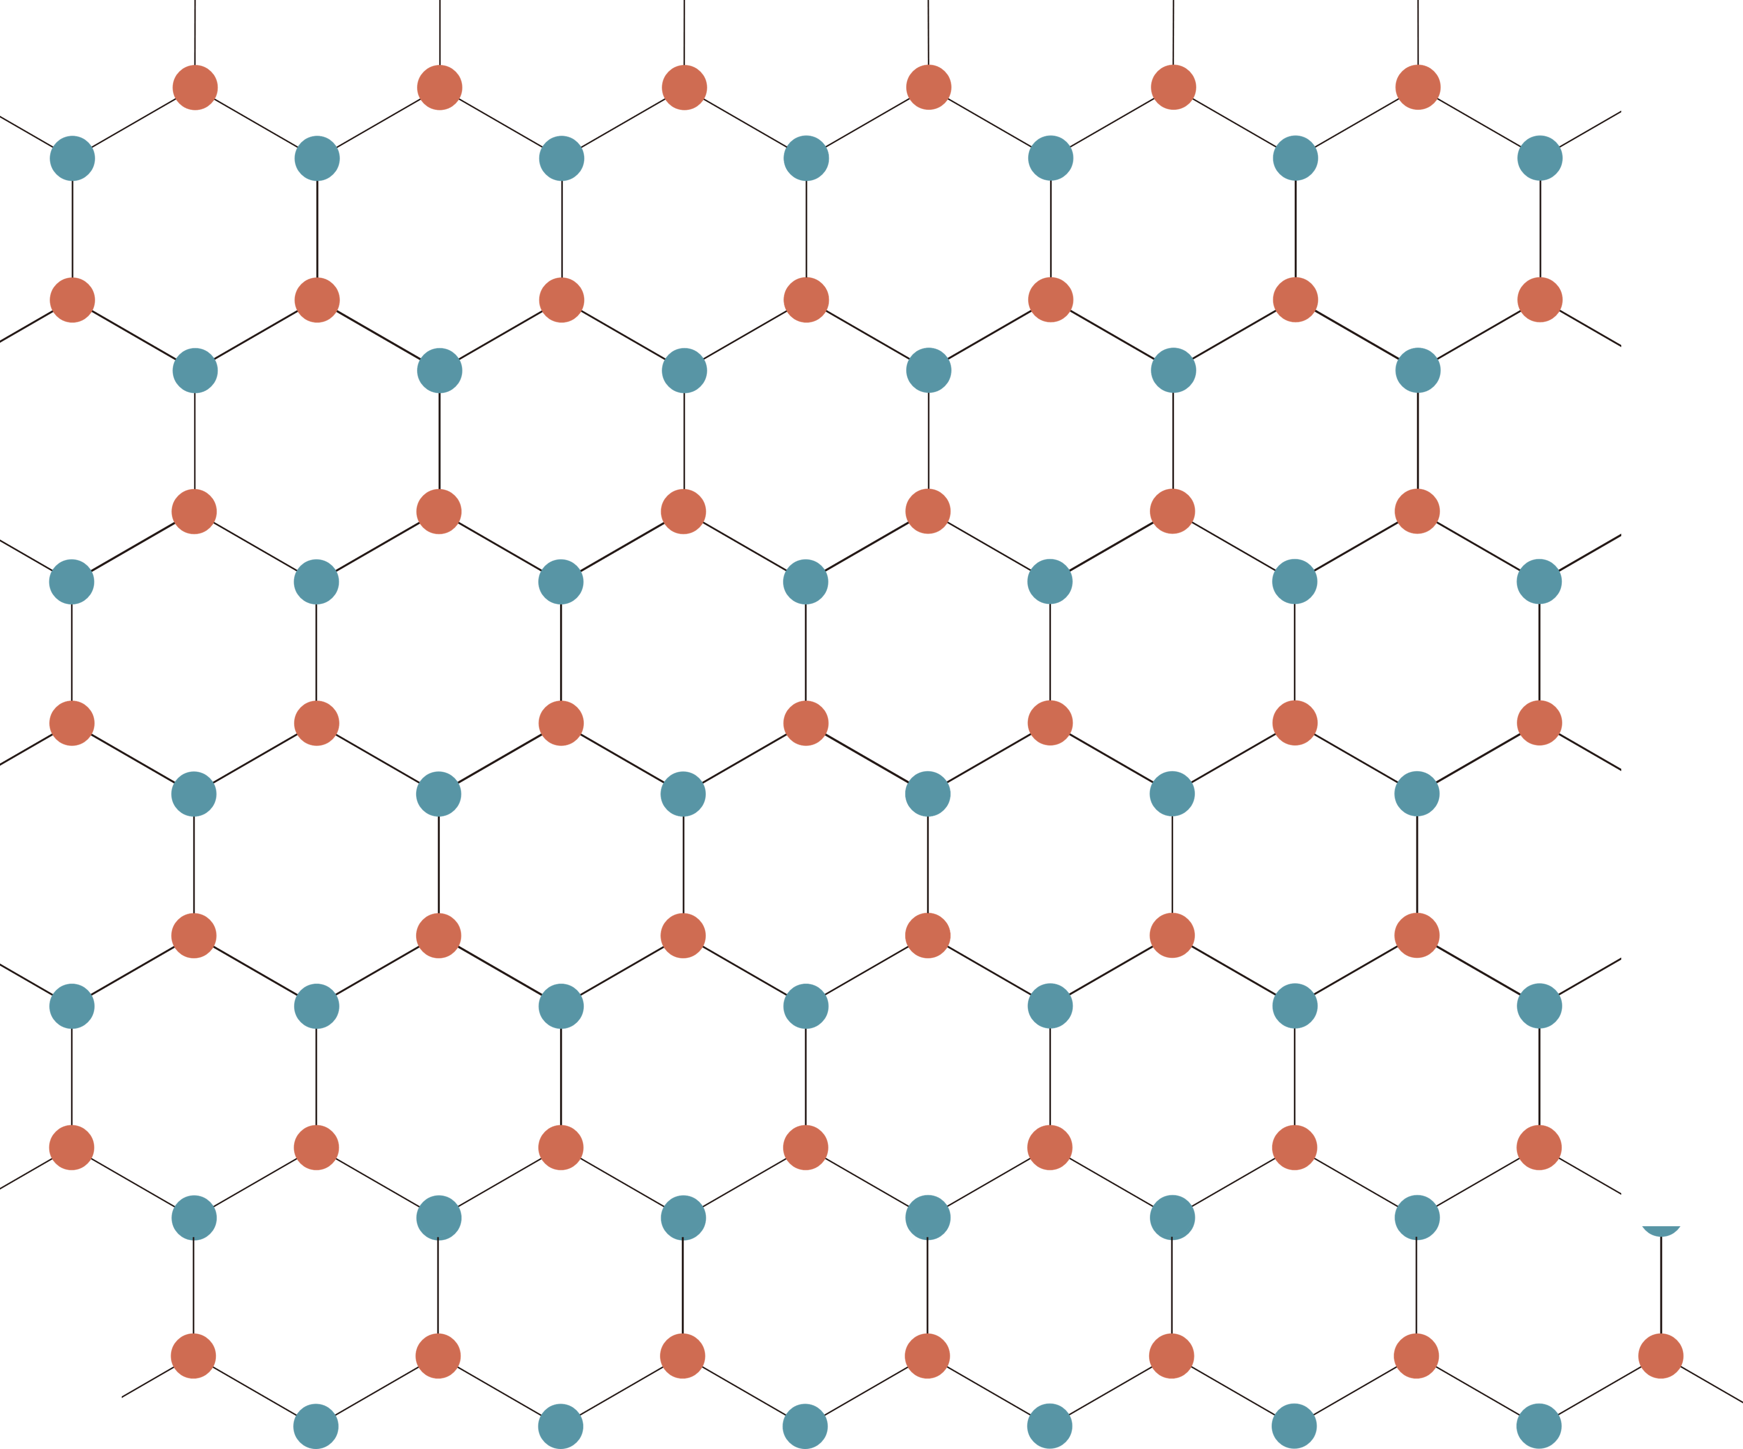
Haldane Model
Graphene
Hamiltonian in real space
Fourier series expansion
Hamiltonian in k-space
Graphene

Slide 4
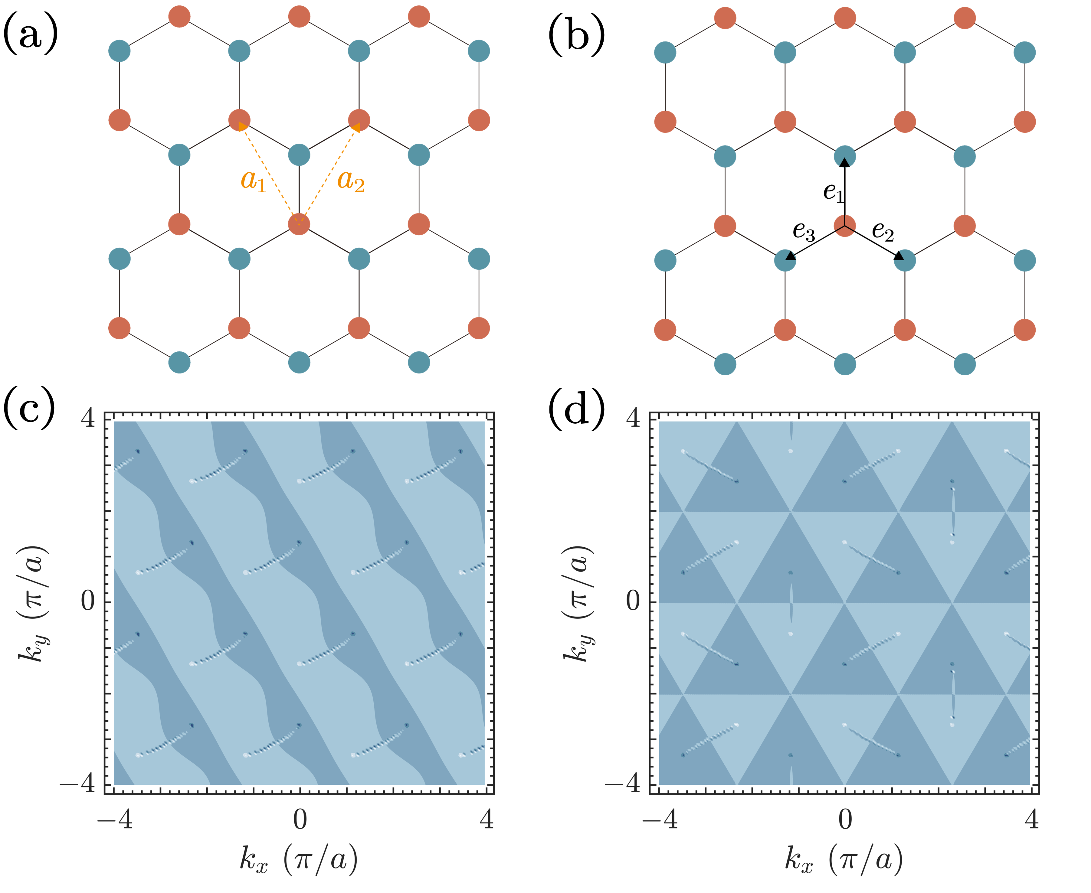
Haldane Model
Graphene
Hamiltonian in real space
Fourier series expansion
Lattice gauge
Atomic gauge
Hamiltonian in k-space
Berry curvature is not the same under different gauges.
Notes:
U(1)×SU(2) gauge

Slide 5
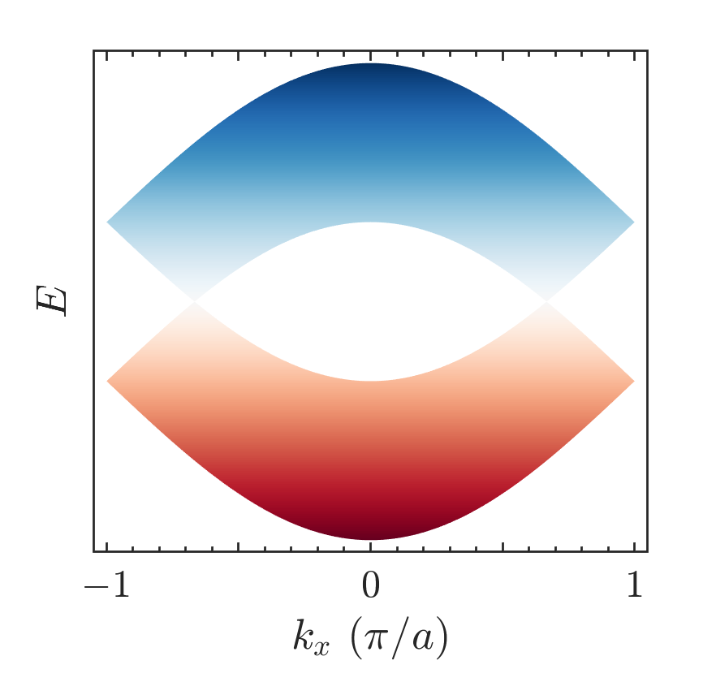
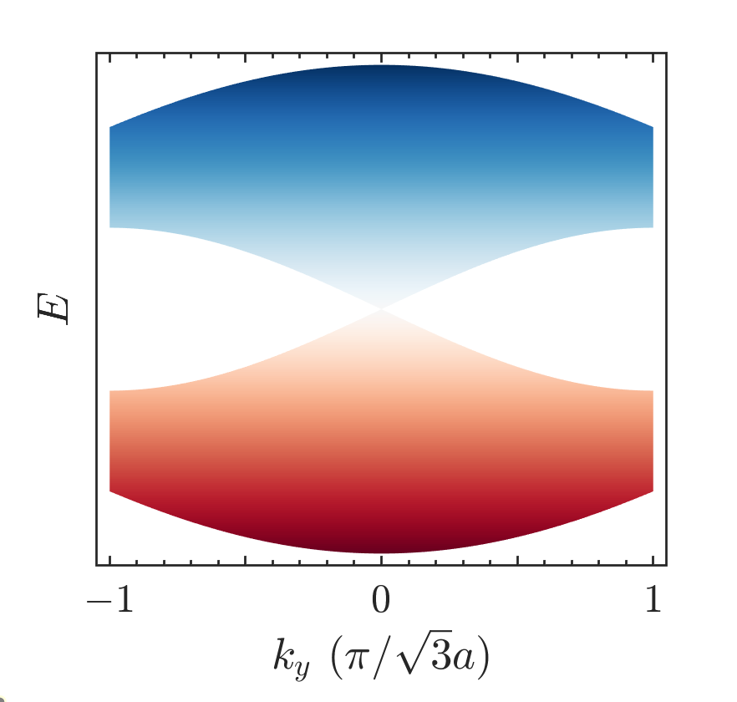
Haldane Model
Graphene
Band structure (Bulk)

Slide 6
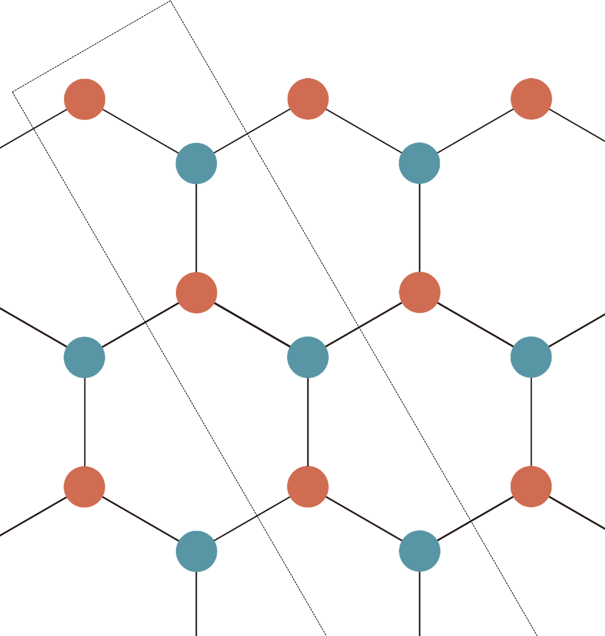
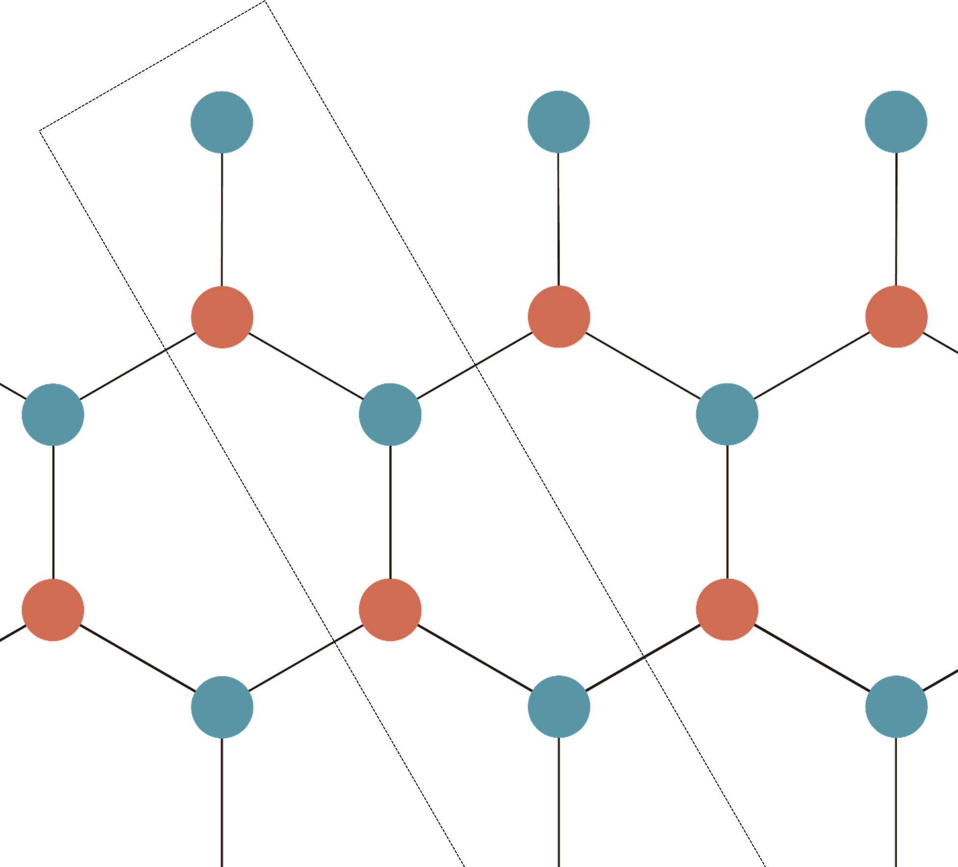
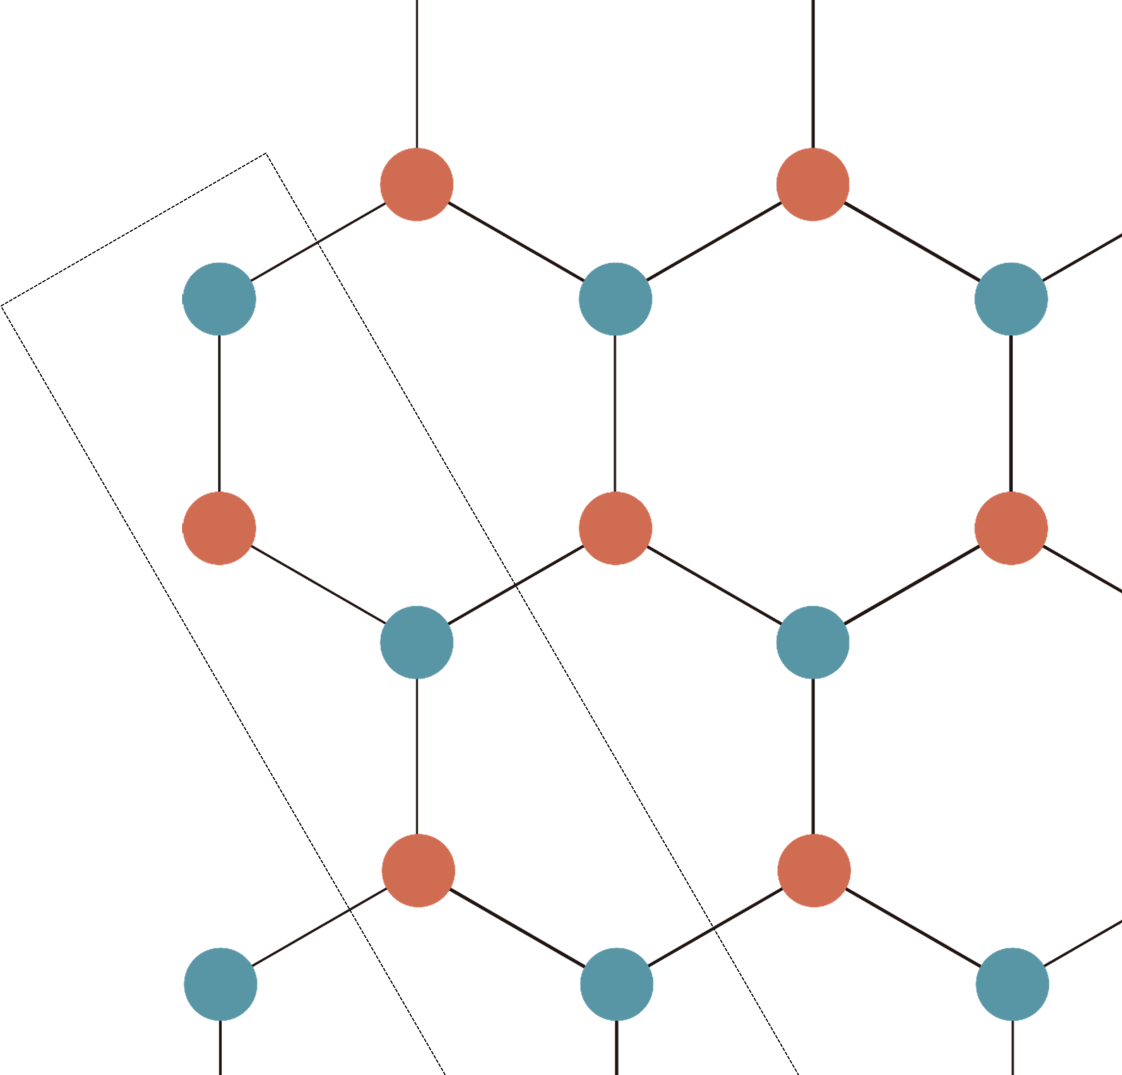
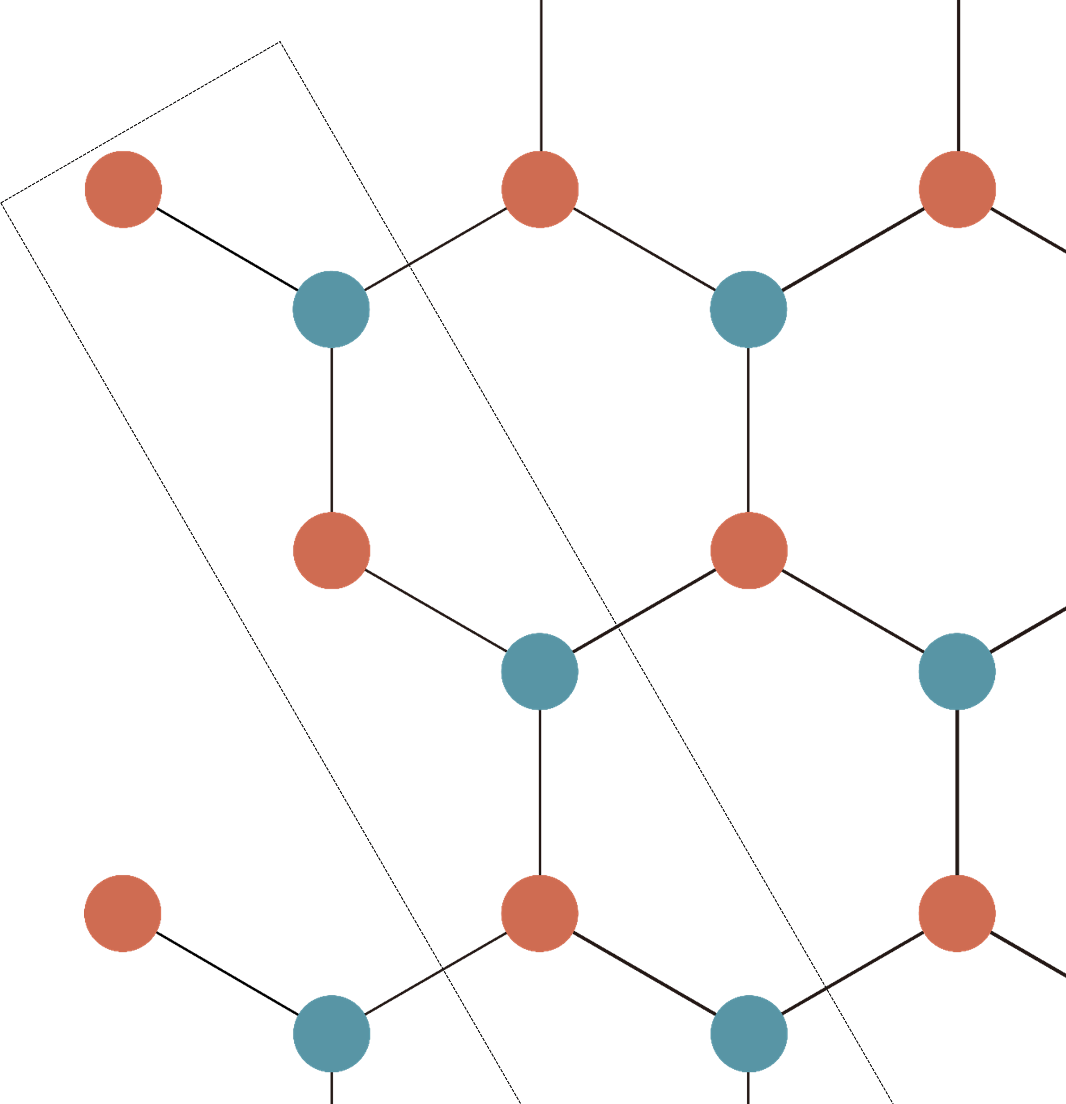
Haldane Model
Graphene
Zigzag
Bearded
Armchair
Twig

Slide 7
Haldane Model
Graphene
Hamiltonian for zigzag edge (a) and bearded edge (b)
Hamiltonian for armchair edge (c) and twig edge (d)

Slide 8
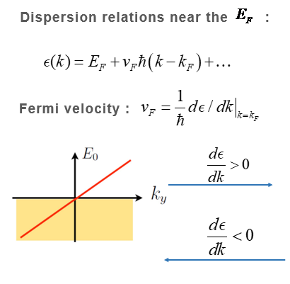
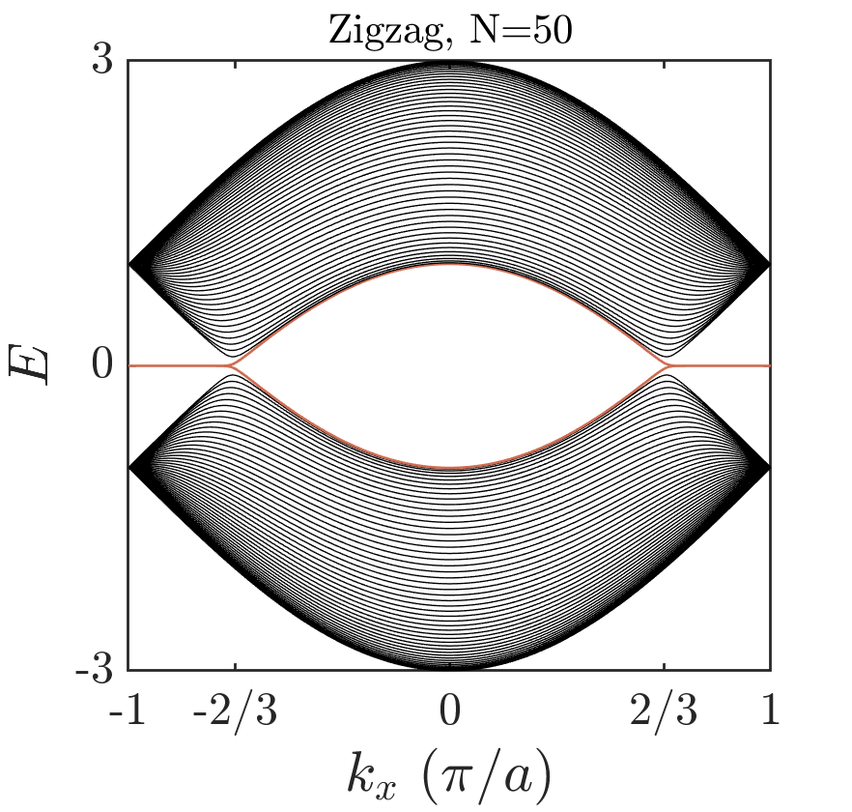
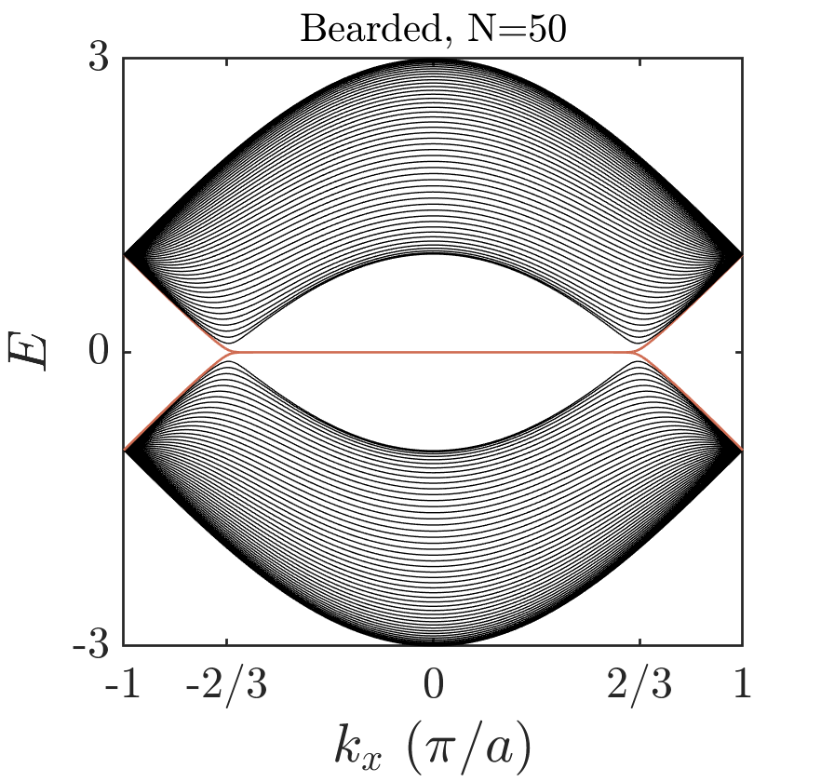
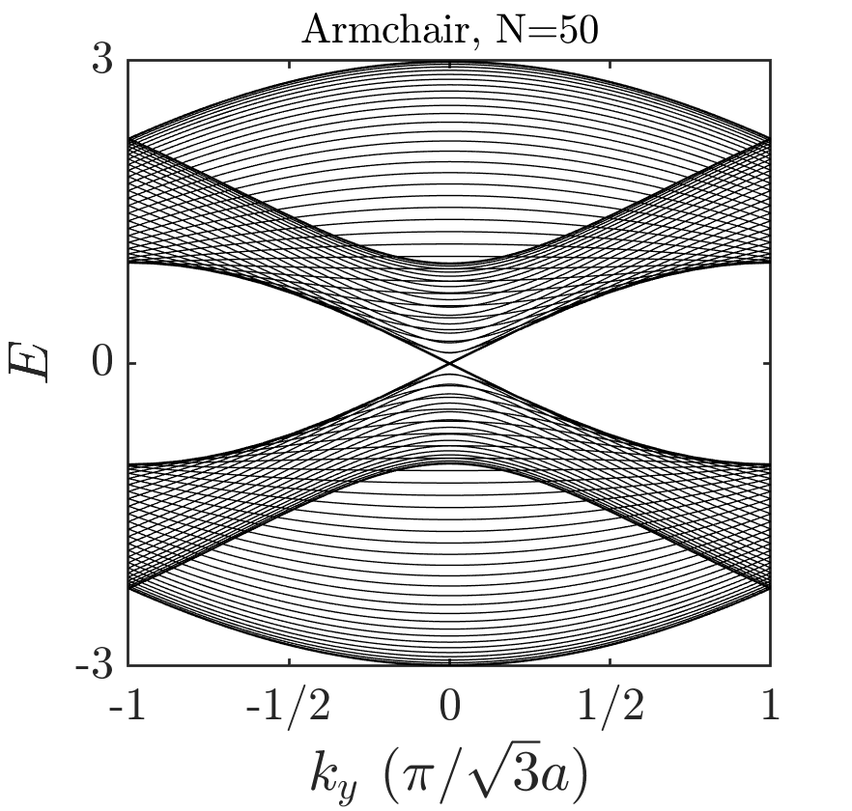
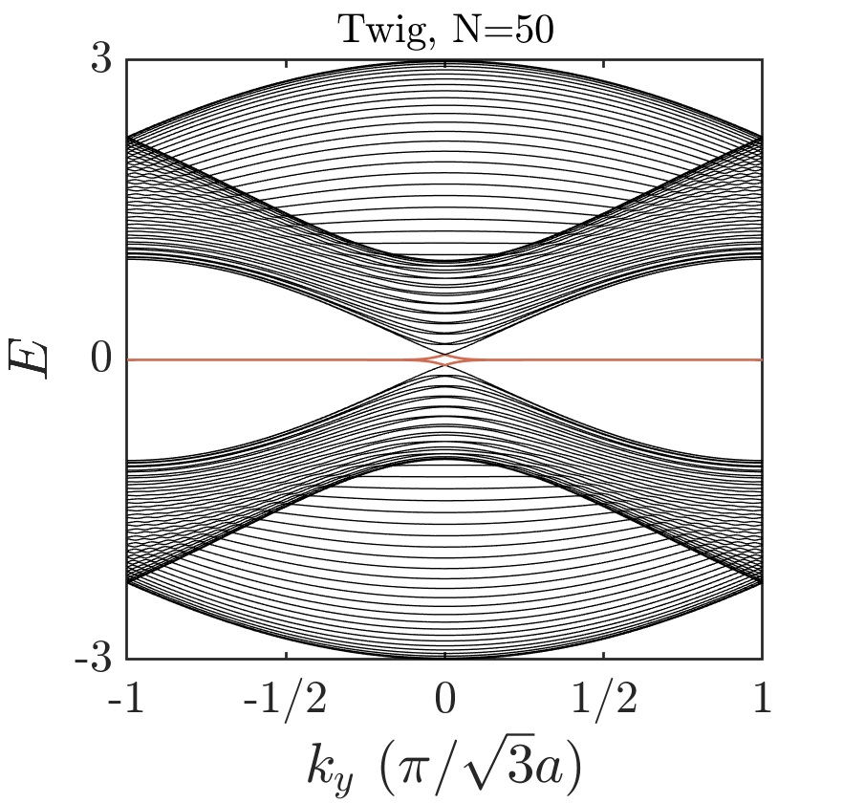
Haldane Model
Graphene
Bulk
Boundary
Located

Slide 9
Haldane Model
Graphene
Shrödinger equation
The quantum Langevin equation in expectation value form

Slide 10
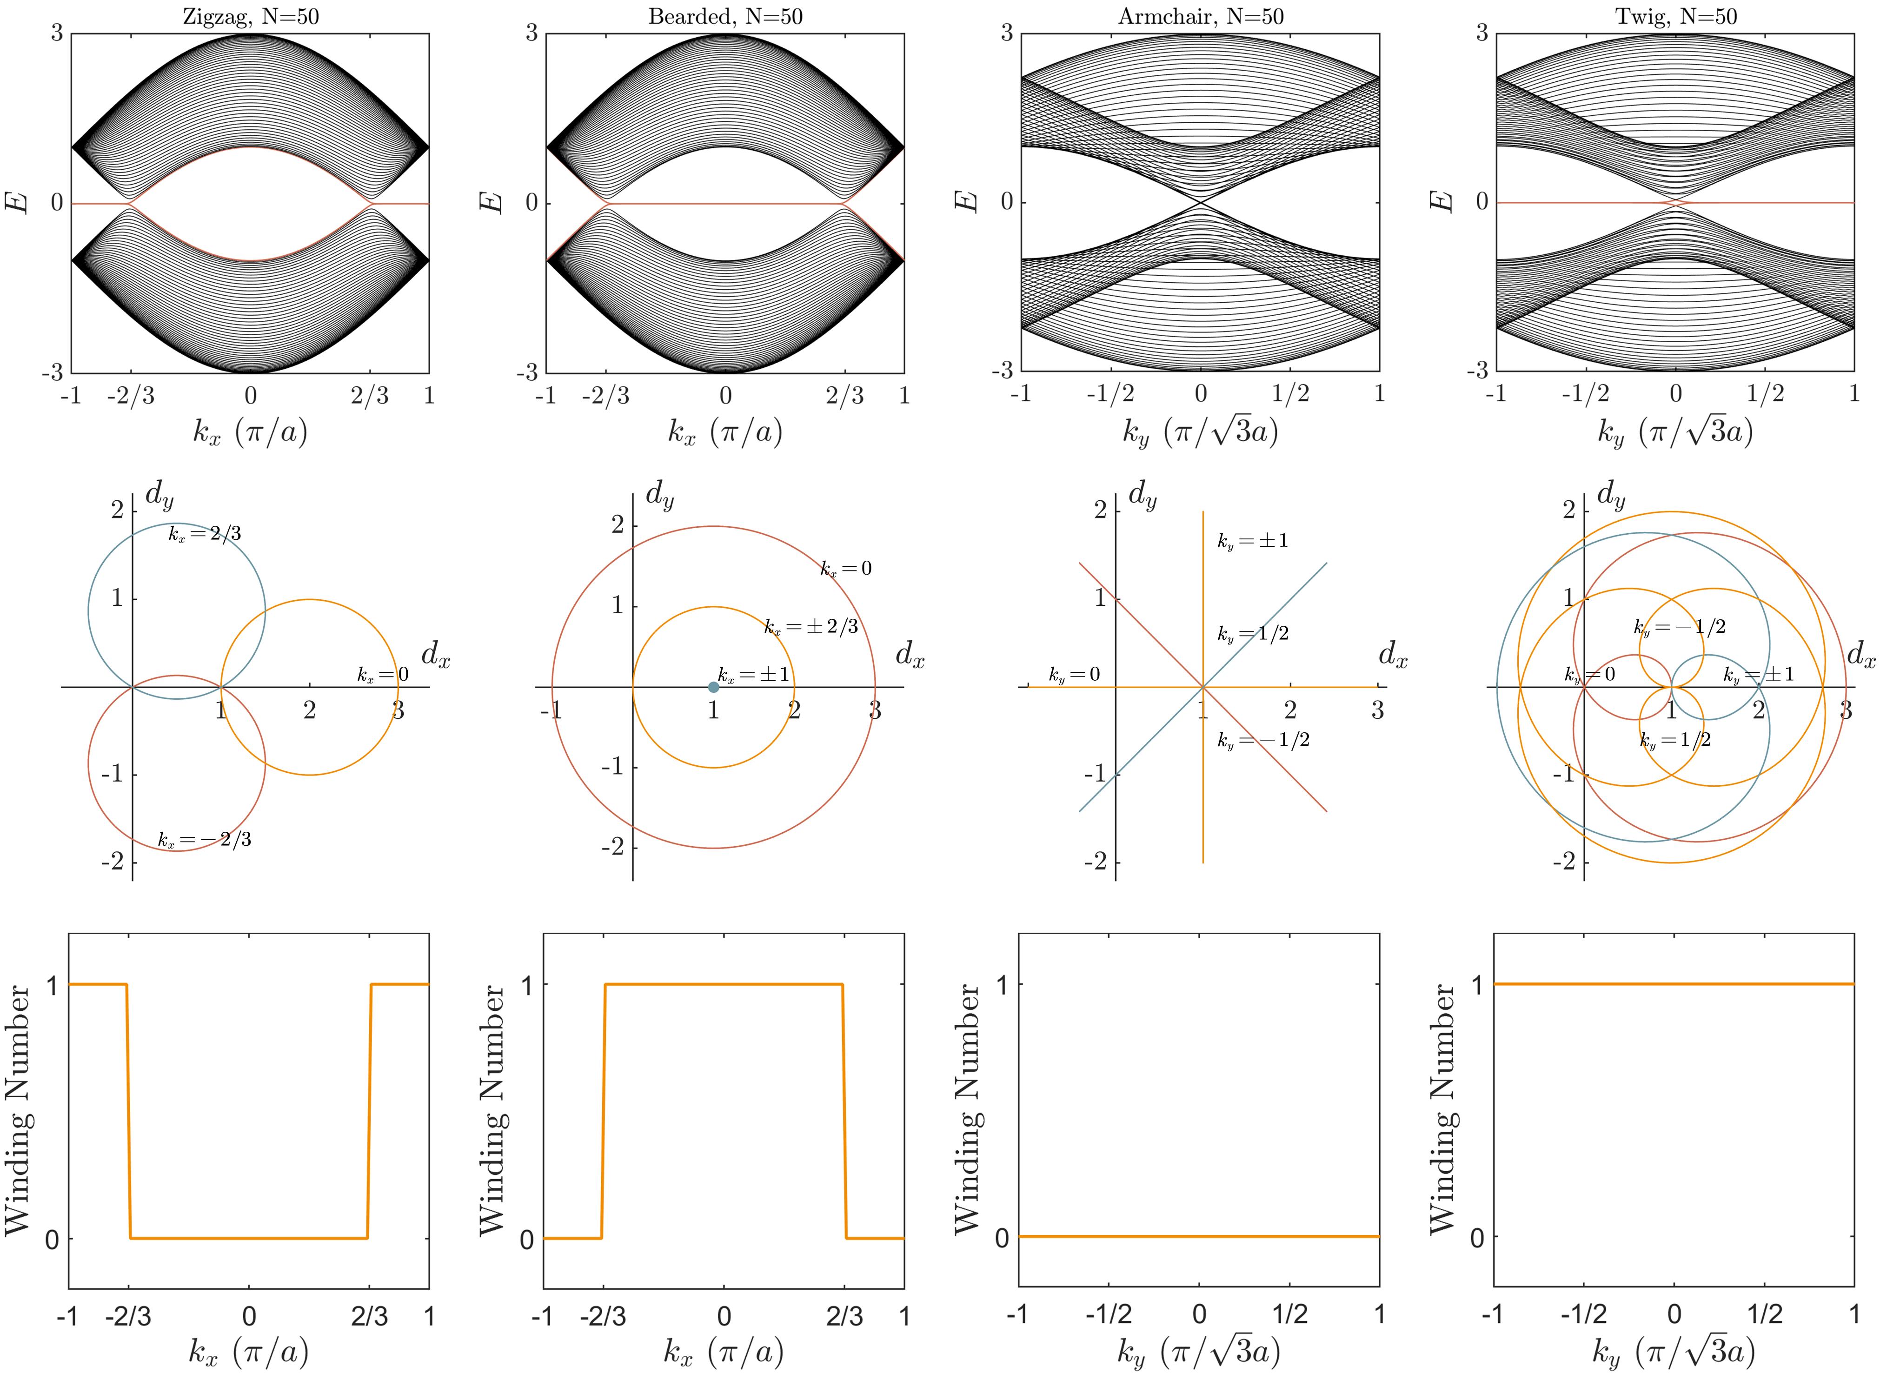
Haldane Model
Graphene
Hamiltonian for winding loops and winding numbers

Slide 11
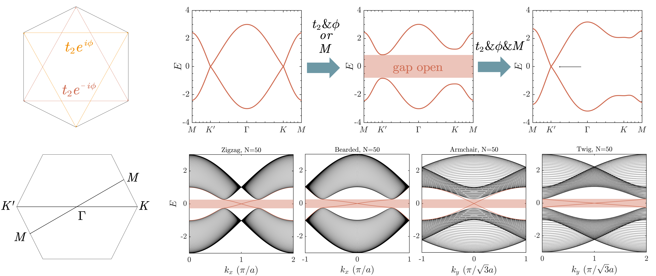
Haldane Model
Chiral edge states

Slide 12
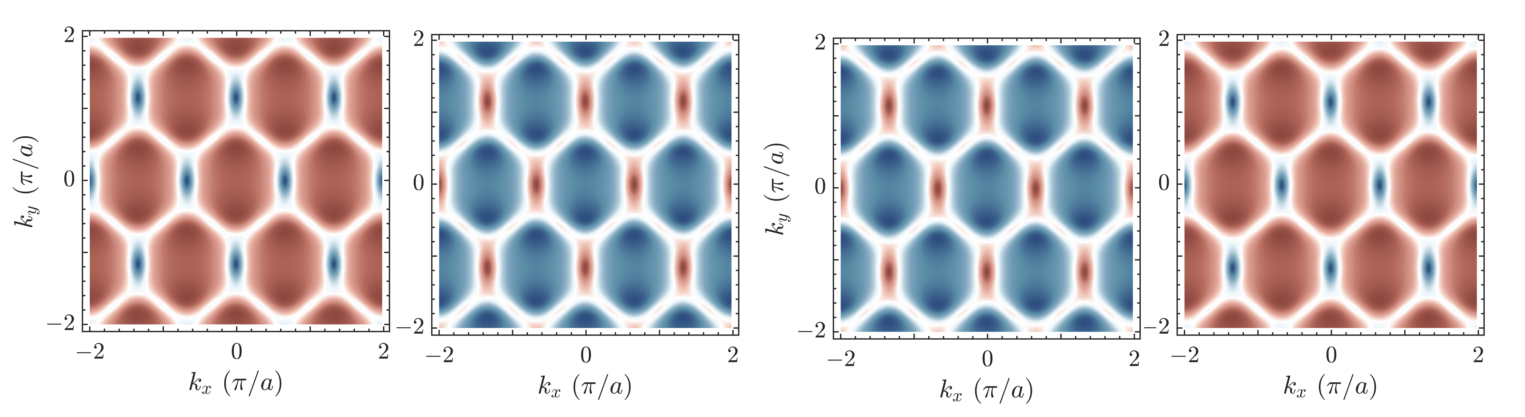
Haldane Model
Chiral edge states

Slide 13
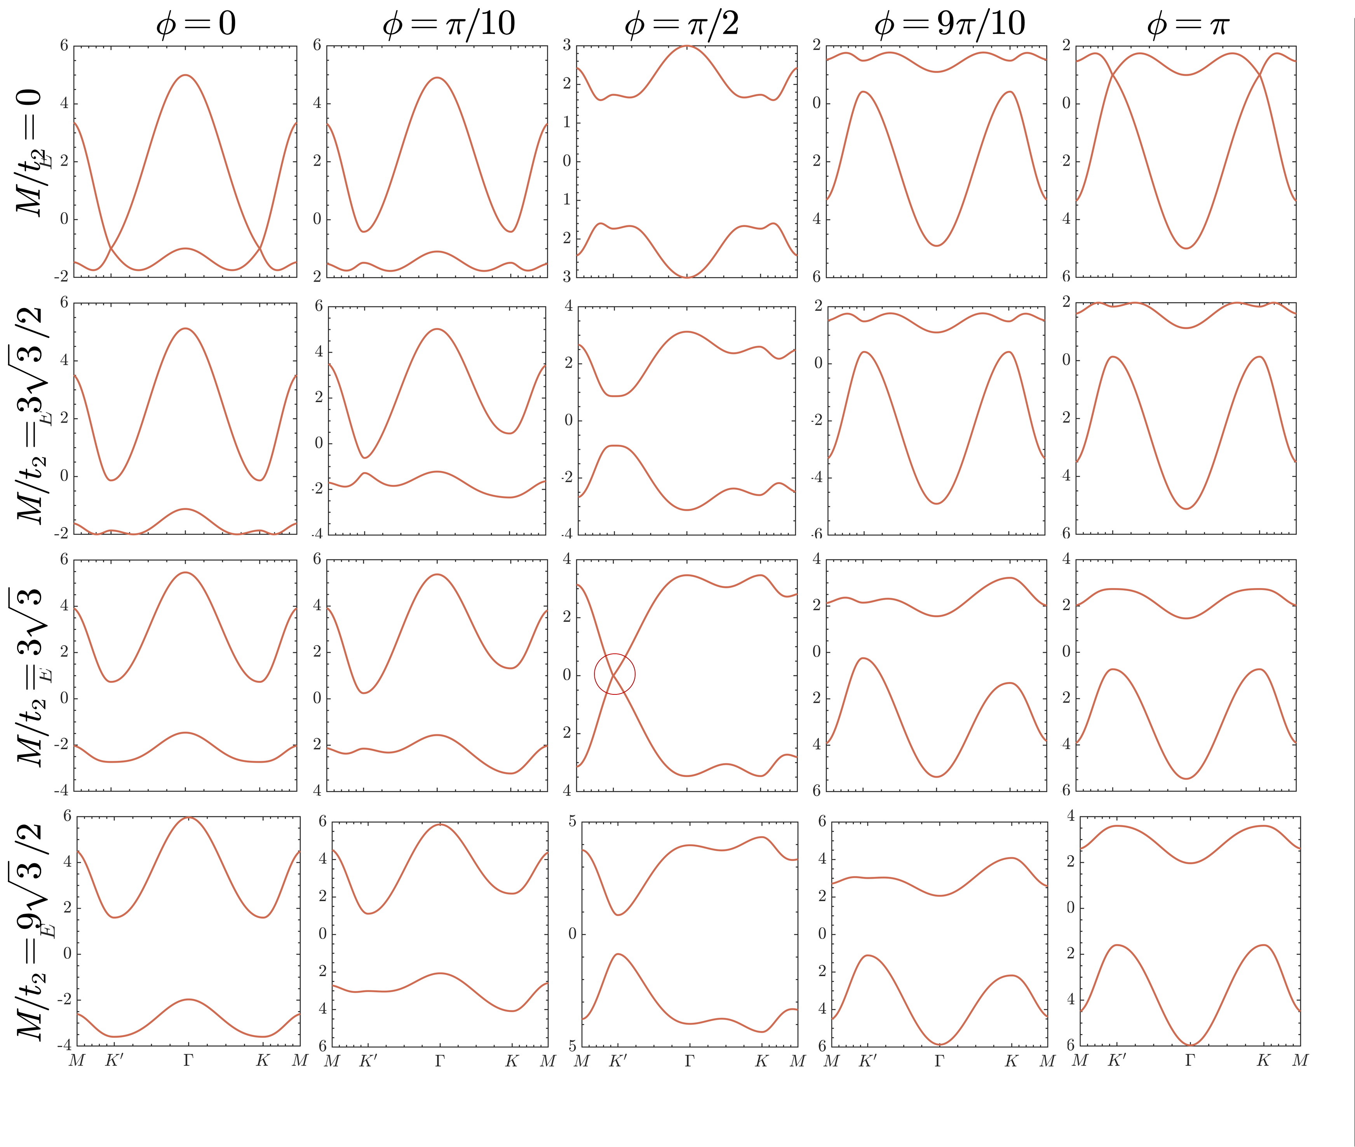
Haldane Model
Parity Anomaly (unpaired Dirac point)

Slide 14
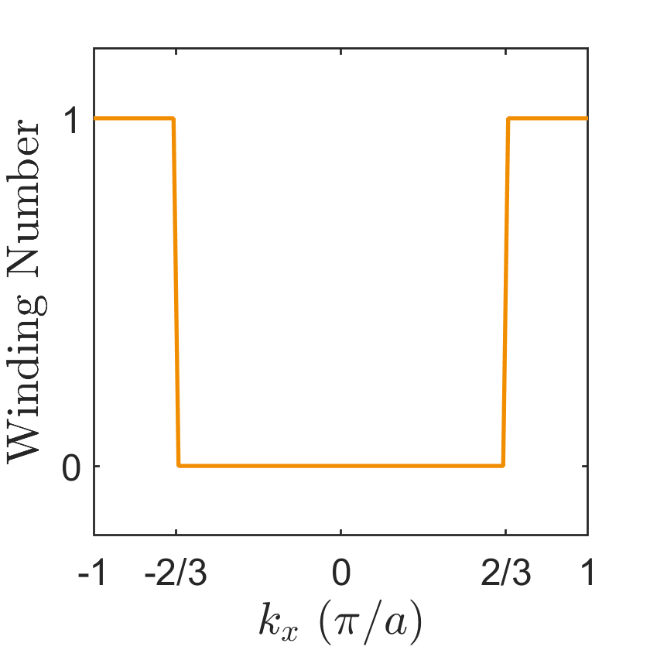
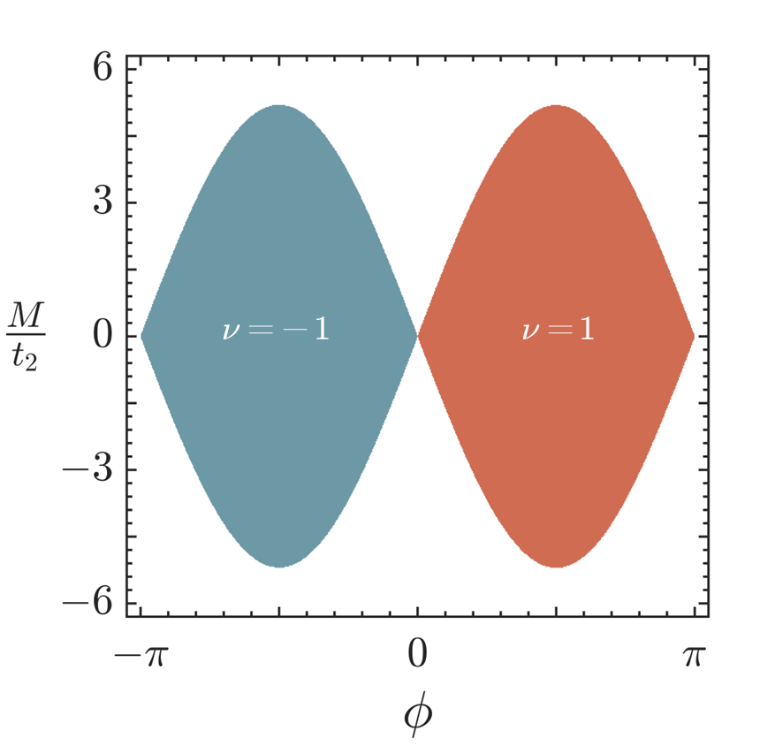
Haldane Model
Conclusion
Graphene
Topological flat band
Edge localization
Topological invariant
Band structure (Bulk)
Band structure (Boundary)
Chiral edge state
Topological invariant
Unpaired Dirac point
Haldane Model

Slide 15
THANK YOU
Bo Zhao
School of Engineering
September 19, 2024

